Slide 1

CollegeLife
Social Media App JUST for College Students
By: Wilson Quilli
Course - SWENG 861: Software Construction
Professor Santosh Nalubandhu

Slide 2



Problem Statement
General social media isn’t designed specifically for college students, mixing personal, professional, and public audiences reduces authenticity
CollegeLife is exclusive to students with verified university emails and provides a trusted, campus-focused space to share college experiences
Accounts are deleted after graduation to keep it student-only, but users can download and save their memories before removal
Target Users: College students

Slide 3
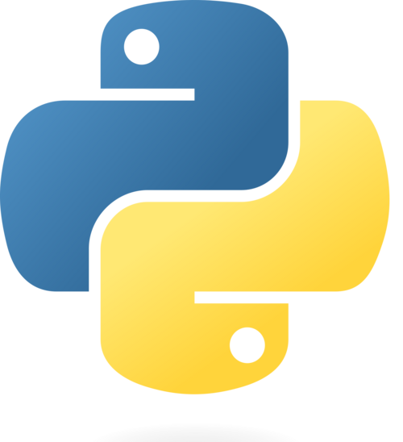






Tech Stack for CollegeLife
Frontend: React
Backend: Python (Flask)
Auth: Google OAuth
Database: Supabase
External APIs: Spotify, Yelp,
OpenWeather, API Ninjas
Media storage: Cloudinary

Slide 4
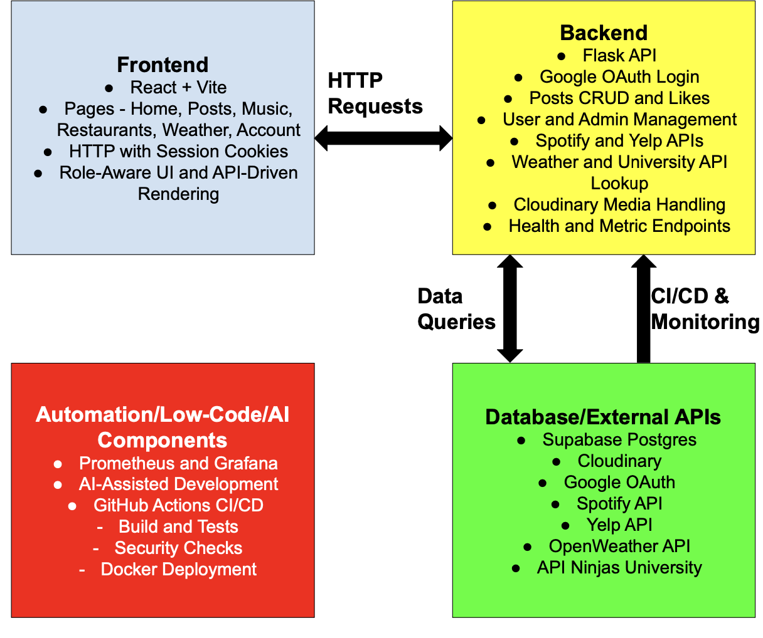
CollegeLife Diagram

Slide 5
Challenges
OAuth state/cookie mismatch from mixed hosts (localhost vs 127.0.0.1) and stale sessions.
Media upload 500 errors from missing Cloudinary config or bad upload payloads.
Frontend buttons/routes not consistently wired to backend auth/API state.
Spotify integration loops/failures across login/callback states.
Opportunities
Large controller files (main.py) make regressions more likely.
Test coverage can pass locally but fail in CI if measurement surface changes.
Observability helped identify auth/redirect failures faster.

Slide 6
Add-on Features
Admin audit log (who deleted/updated what and when).
Soft-delete + restore for posts/accounts.
Light Mode.
A saved posts features or bookmarks.

Slide 7
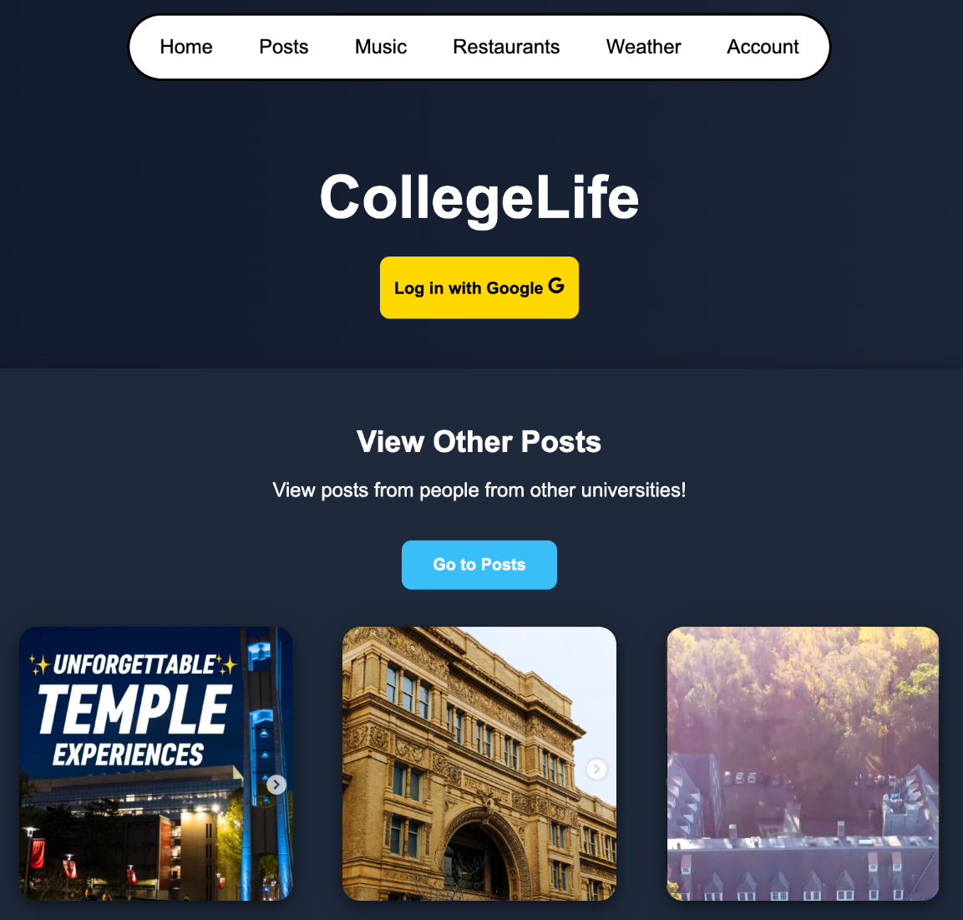
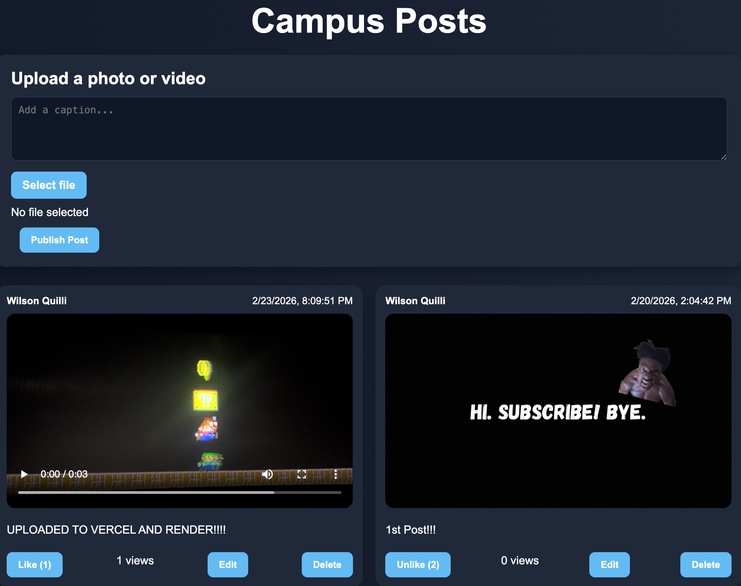
Screenshots of CollegeLife
Home Page
Post Page

Slide 8
Key Use Cases
User signs in with Google OAuth (.edu required for regular users; configured admin emails bypass).
User lands on Home page and sees personalized login state (Welcome {user}).
User navigates to Posts, uploads photo/video (Cloudinary), adds caption, and publishes post.
User views community post feed, likes posts, and registers views.
User opens Music page, connects Spotify, and fetches current track metadata.
User opens Restaurants page, searches by location/term, and views Yelp results.
User opens Weather page, searches city, and sees current weather details.
User opens Account page to view profile/session info.
Admin opens Account page, sees all accounts, and can delete user accounts.

Slide 9

CSS Responsive Design
CollegeLife offers support to function and display on both mobile devices such as tablets and phones and on computers through CSS responsive design.

Slide 10
Closing Statements
Lessons learned
Consistent environment/config management is critical, especially for OAuth and cross-origin session flows.
Coverage gates are useful only when scoped intentionally and kept stable across CI/local.
How I plan to apply these skills
Start future projects with environment validation, standardized config, and deployment profiles from day one.
Build CI/CD pipelines early (build + test + security + package), not at the end of development.
Reflection on tools (and what to use next)
CI/CD (GitHub Actions) was the highest-leverage tool for maintaining release confidence.
AI assistance was useful for rapid iteration, debugging, and test scaffolding, but still required strict verification and review.

Slide 11
Thank you!

